Slide 1
Virtual Networks

Slide 2
Azure Networking Components
Virtual Network
Subnets
Public and Private IP
Load Balancer
Traffic Manager
NIC
NSG

Slide 3
Virtual Networks
An Azure Virtual Network (VNet) is a representation of your own network in the cloud.
It is logical isolation of Azure cloud dedicated to your subscription

Slide 4






Virtual Networks
CIDR – Classless Interdomain Routing
10.0.0.0/16 – Collection of IP Address – 65536
32 – 16 = 16
2 to the power 16 = 65536
10.0.0.0/24 = 256
32-24 = 8, 2 to the power 8 = 256

Slide 5
Private IP Address Range
10.0.0.0 - 10.255.255.255
172.16.0.0 - 172.31.255.255
192.168.0.0 - 192.168.255.255

Slide 6
Subnet
A virtual network can be segmented into one or more subnets.
Subnets provide logical divisions within your network
10.0.0.0/16 - VNet
10.0.0.0/24 – 256 – Subnet
5 IPs will be reserved by Azure

Slide 7
Subnets
Service Requirement
Service endpoints – You can limit the access to Azure resources
Network Security Groups – You can associate zero or one network security group to each subnet in a virtual network

Slide 8
IP Addressing

Slide 9
IP Addressing
Private IP Address – communication within azure virtual network
Public IP Address – communication with the internet
Static or dynamically
DNS name resolution
IP address-based security
SSL certificates
Firewall rules

Slide 10
Public IP Addresses
Public IP Address | IP Address association
Virtual Machine | NIC
Load Balancer | Front-end configuration
VPN Gateway | Gateway IP configuration
Application Gateway | Front-end configuration
SKU:
Basic
Standard

Slide 11
Private IP Addresses
Public IP Address | IP Address association
Virtual Machine | NIC
Internal Load Balancer | Front-end configuration
Application Gateway | Front-end configuration

Slide 12
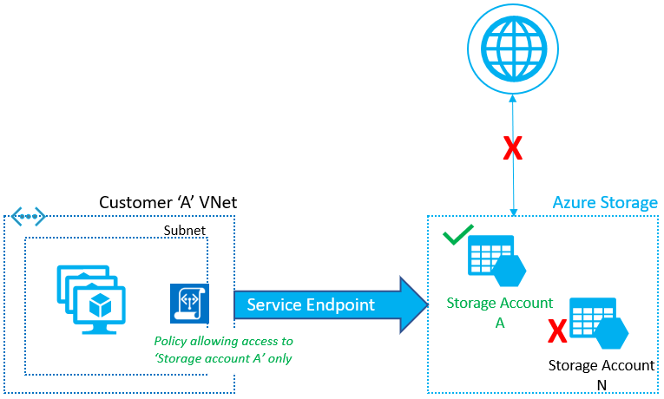
Service Endpoints
Provides the identity of your virtual networks to the Azure service.

Slide 13
Service Endpoints Benefits
Improved security for Azure service resources
Optimal routing for Azure service traffic from your virtual network
Simple to setup with less management overhead

Slide 14
Network Security Group

Slide 15






Network Security Group
You can limit network traffic to resources in a virtual network
NSG contains list of security rules that allow or deny inbound or outbound network traffic
Associated with subnet and NIC

Slide 16
NSG Rules
Inbound – 3 Default
Outbound – 3 Default

